Slide 1

Binary and computer logic
Lesson 2: Introducing binary

Slide 2
Objectives
In this lesson, you will learn:
what the binary system is
how binary numbers relate to denary numbers
how to count in binary
how to convert binary numbers to denary numbers.

Slide 3
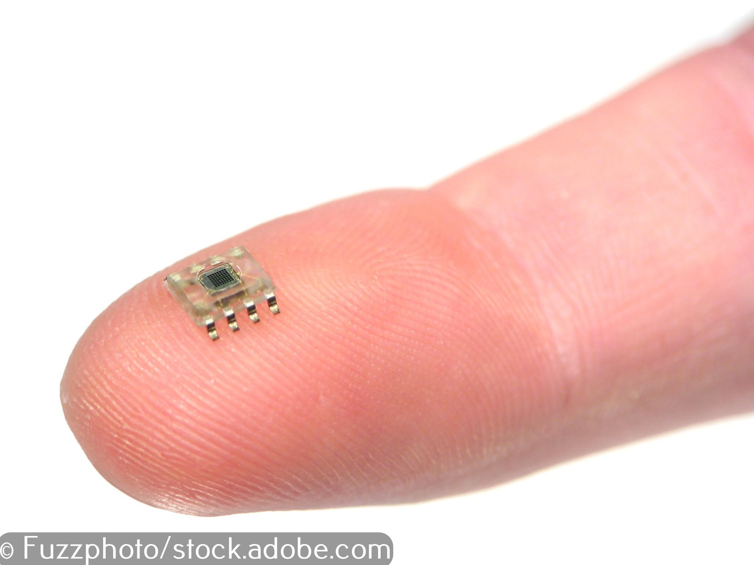
The CPU and logic gates
The CPU, the processor at the heart of every digital device, is composed of millions of microscopic electronic circuits called logic gates.
There are only two possible states for the inputs to, and the outputs from, a logic gate: ON represented by 1 and OFF represented 0.
Computer programmers write computer code and this is converted, by a translator, into 1s and 0s that activate the logic gates in the CPU.
An integrated circuit containing millions of logic gates, on a fingernail!

Slide 4
Counting in denary
You should be familiar with the decimal system, which uses ten digits: 0, 1, 2, 3, 4, 5, 6, 7, 8 and 9.
The decimal system is also known as the denary system or base 10.
In base 10, place values increase in multiples of 10. The units are followed by 10s, the 10s are followed by 100s and the 100s are followed by 1000s and so on.
1000s | 100s | 10s | 1s | Place values | Denary number
 |  |  | 8 | 1 × 8 | 8
 |  | 2 | 5 | (2 × 10) + (5 × 1) | 25
 | 3 | 6 | 2 | (3 × 100) + (6 × 10) + (2 × 1) | 362
1 | 0 | 4 | 0 | (1 × 1000) + (4 × 10) | 1040

Slide 5
Counting in binary
The binary system uses just two digits: 0 and 1.
The binary system is also known as base 2.
In base 2, place values increase in multiples of 2. The units are followed by 2s, the 2s are followed by 4s, the 4s are followed by 8s and the 8s are followed by 16s and so on.
16s | 8s | 4s | 2s | 1s | Place values | Denary number
 |  |  |  | 1 | 1 ×1 | 1
 |  |  | 1 | 0 | (1 × 2) + (0 × 1) | 2
 |  | 1 | 1 | 1 | (1 × 4) + (1 × 2) + (1 × 1) | 7
 | 1 | 0 | 1 | 0 | (1 × 8) + (1 × 2) | 10
1 | 1 | 0 | 0 | 1 | (1 × 16) + (1 × 8) + (1 × 1) | 25

Slide 6

Activity 2.1: Counting in binary

Slide 7
Activity 2.2: Binary to denary conversion

Slide 8
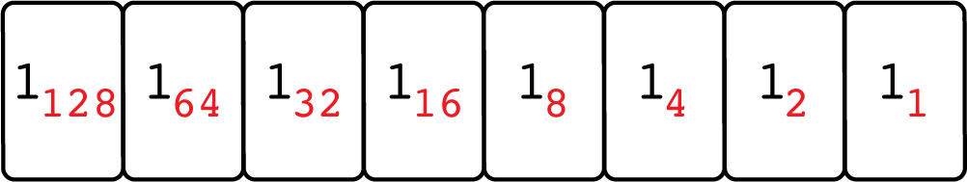
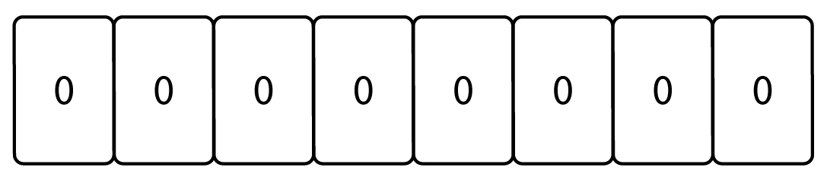
Binary to denary conversion
Lay out the cards with the denary numbers uppermost as shown:
Without changing the order of the cards, turn each card over so that the 0 on the back is showing:

Slide 9
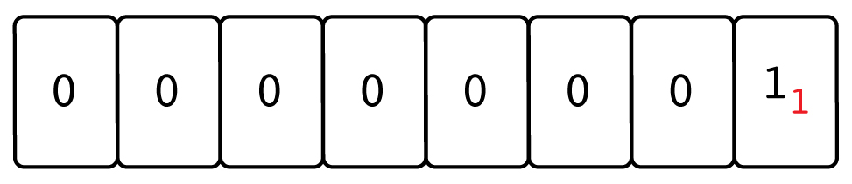
Converting binary 1 to denary
Turn over the card on the far right:
The card on the far right now represents the binary number 1.
The denary equivalent of the binary digit is the red number in the bottom left-hand corner of the card; in this case 1.
Binary 1 is denary 1.

Slide 10
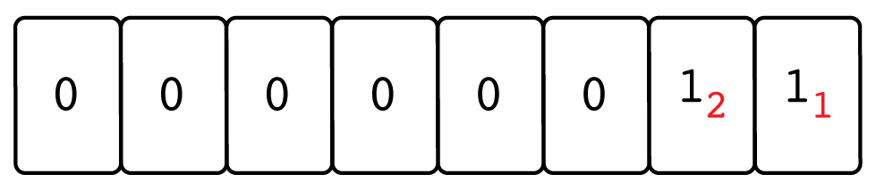
Converting binary 11 to denary
Turn over the two cards on the far right:
The two cards on the far right represent the binary number 11.
The denary equivalent is the sum of the red numbers; in this case, 2 + 1 = 3.
So binary 11 is denary 3.

Slide 11
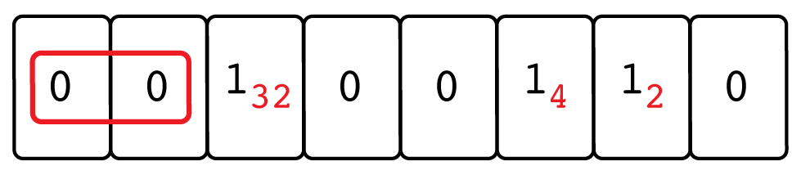
Converting binary 100110 to denary
Working from right to left, turn over the cards that correspond to a 1 in the binary number 100110. Ignore the 0s on the left-hand side of the first 1; they have no numerical value.
The six cards on the right represent the binary number 100110.
The denary equivalent is the sum of the red numbers;
in this case, 32 + 4 + 2 = 38
So binary 100110 is denary 38.

Slide 12
Activity 2.3: Adding binary numbers

Slide 13
Quiz 2

Slide 14
Activity 2.4: Planning an app

